Slide 1


Analytics Assignment

Slide 2

Content
Data summary
Monthly transactions
Most Popular Products/Services
Daily Revenue Trend
Average Transaction Amount by Product Category
Transaction Funnel Analysis
Monthly Retention Rate
Feedback

Slide 3
Dataset
Here is the link of the data which we will be analyzing : click me
Dataset features in a gist:
Id
user_id
merchant_name
merchant_type,
mcc
transaction_amount
transaction_currency
billing_amount
billing_currency
transaction_status
transaction_timestamp
transaction_type
parent_transaction_id
card_entry
purchase_date

Slide 4
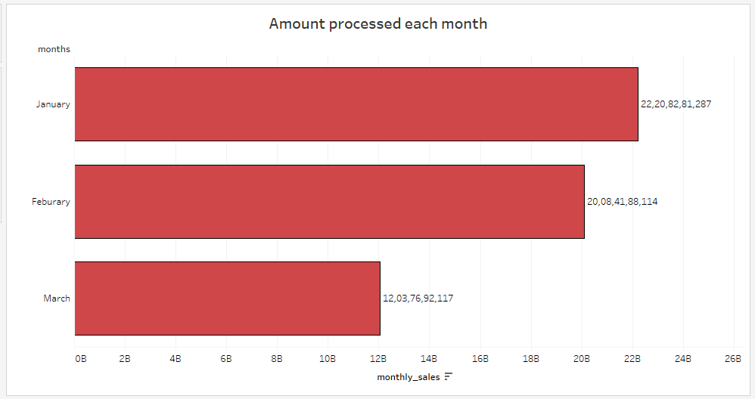
Monthly transactions
How much amount we have processed each month commutative and every month.
January has the highest sales amongst all there months

Slide 5
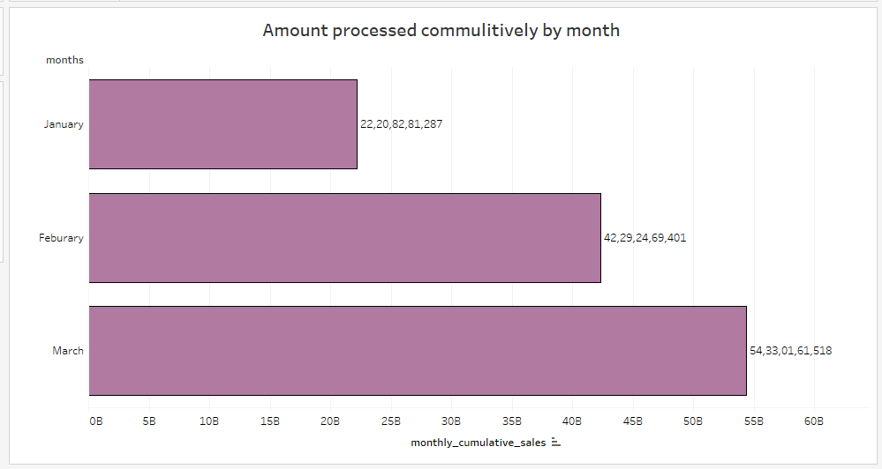
Cumulative sales
The cumulative sales of March gives us our total sales till date

Slide 6
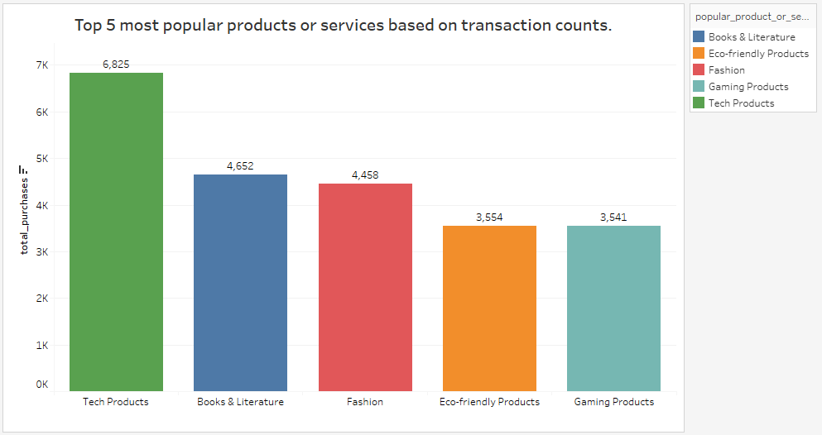
Most Popular Products/Services:
Identify the top 5 most popular products or services based on transaction counts.
Product related to technology has the maximum sales indicating young audience

Slide 7
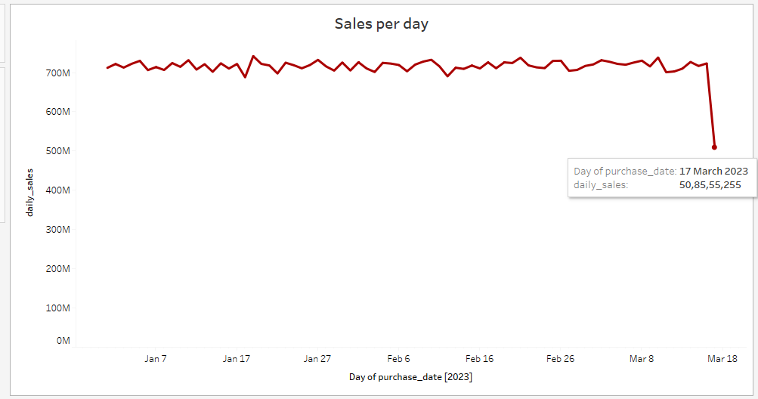
Daily Revenue Trend:
Visualize the daily revenue trend over time.
There is a dip in sales on 17 march a close examination in this area is required

Slide 8
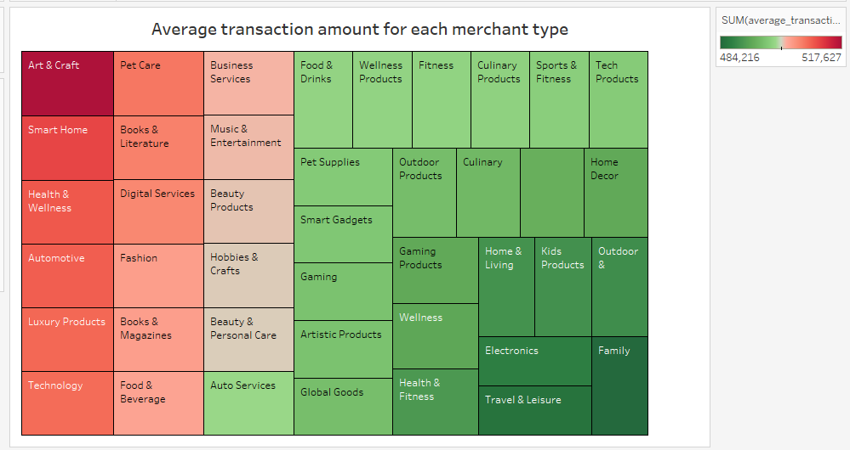
Average Transaction Amount by Product Category:
Find the average transaction amount for each product category.
On an average the products related to arts and Craft are a bit on the expensive side where as

Slide 9
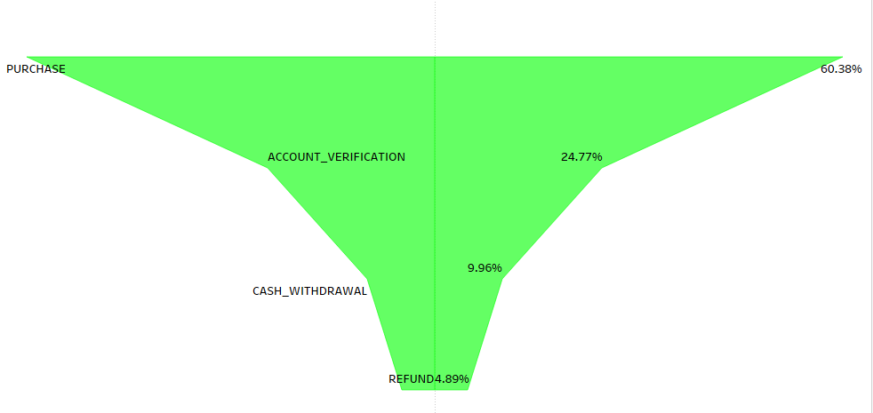
Transaction Funnel Analysis:
analyze the transaction funnel
Purchase funnel
Refunds can be decreased by improving the overall satisfaction of the user with the product

Slide 10
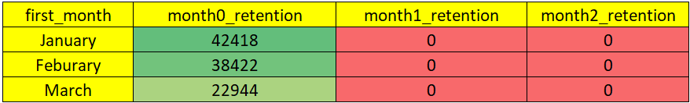
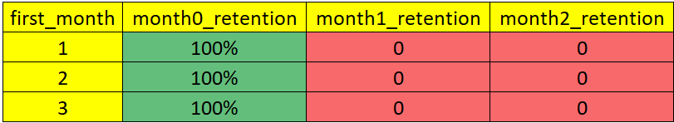
Monthly Retention Rate:
Monthly Retention Rate, grouping users into monthly cohorts.
Retention in terms of user
Retention in terms of rate
We will have to work on customer retention issue we are not able to retain customer

Slide 11

Q & A

Slide 12
FEEDBACK
Understanding the features or columns in a dataset is crucial for gaining a thorough comprehension of the data. In the context of data analysis, knowing what each attribute represents allows for a more effective interpretation and utilization of the information hence having a clear description about features would really help in a better analysis

Slide 13
Thank you

